Slide 1
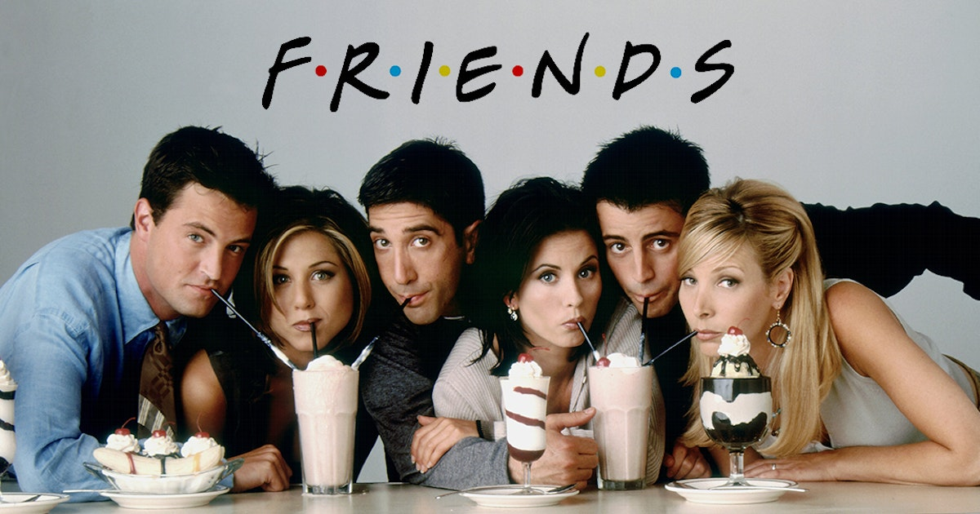
Happy or not? Emotion Analysis of “Friends” based on Language Models
Sara Paolini
08400A
Text Mining and Sentiment Analysis
Course Project

Slide 2
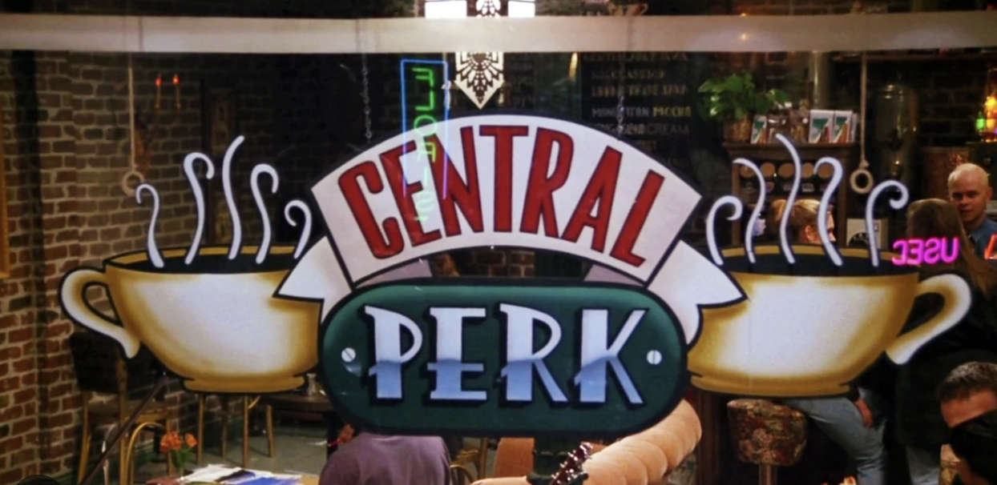
PROJECT GOALS
Creating an “emotional profile” for each of the main characters
Investigating how the emotions of each character evolves of the episodes
Analyzing the emotional influence of diverse characters on each other
Exploring the capabilities of Language Models (LMs) in emotion detection

Slide 3
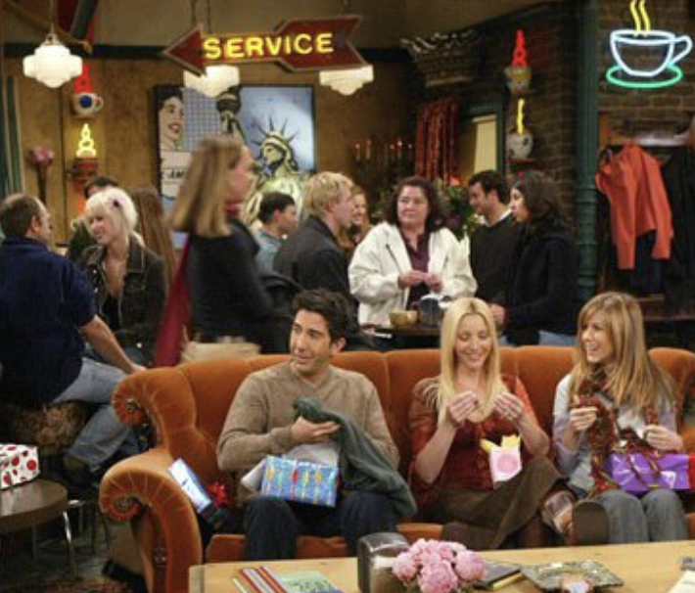
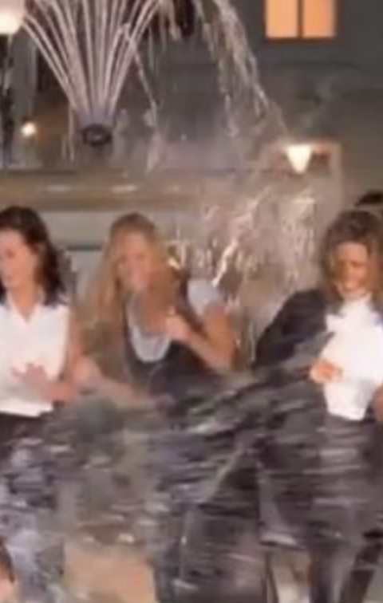

DATASET
“ Friends“ TV - sitcom
Why Friends?
Use of straightforward and direct dialogues simplify the task of emotion recognition
1. True label dataset
Emotion-labelled textual dialogues of :
4 seasons
97 episodes
897 scenes
12,606 utterances
263 characters (speakers)
A publicly available dataset retrieved from ConvoKit (https://convokit.cornell.edu/documentation/friends.html)

Slide 4
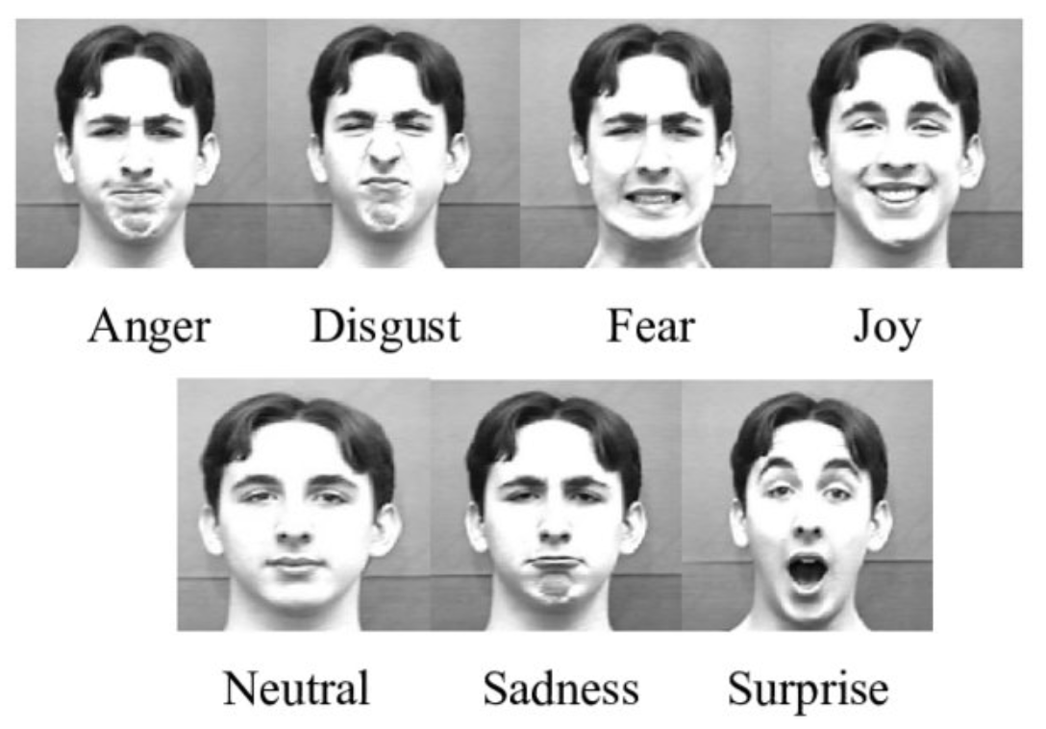
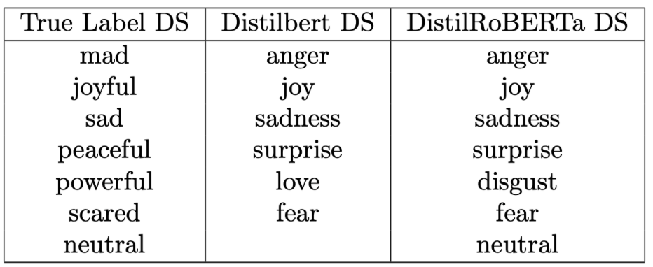
MODELS&DATASET
Two pre-trained LMs from Hugging Face for the creation of 2 new emotion-labelled versions of the True Label dataset
Distilbert-base-uncased-emotion
- compressed version of BERT - smaller faster than BERT
fine-tuned dataset consisting of 11,038 unpublished books and English Wikipedia Distilbert DS
Emotion English DistilRoBERTa
Variant of DistilRoBERTa
trained on 6 diverse datasets (texts from Twitter, Reddit, students’ self-reports, and utterances from TV dialogues) DistilRoBERTa DS

Slide 5

Main results

Slide 6
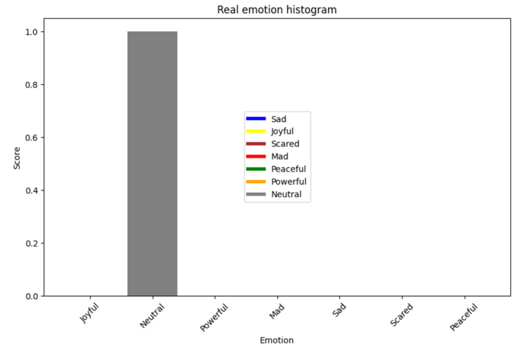
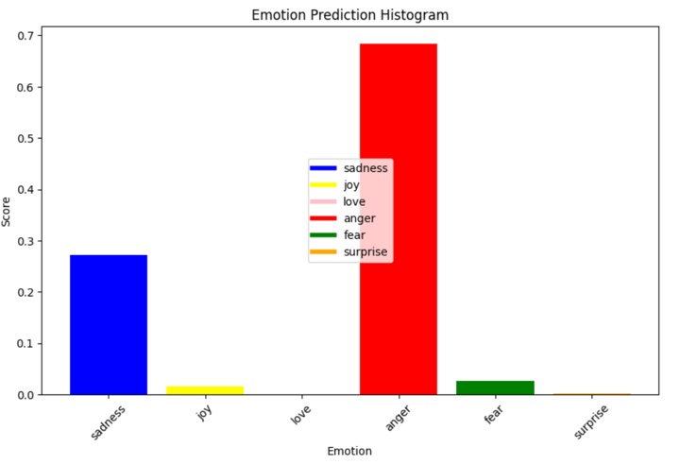
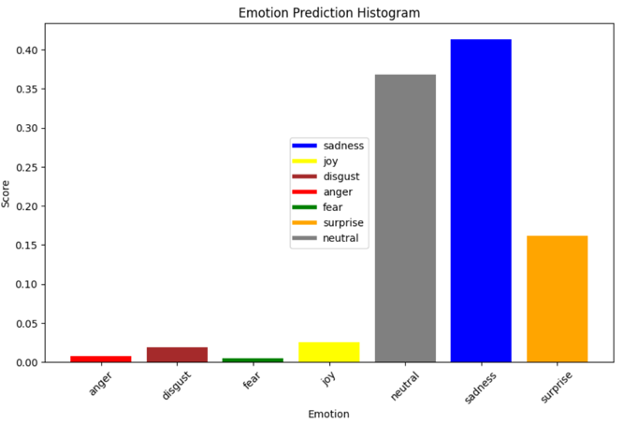
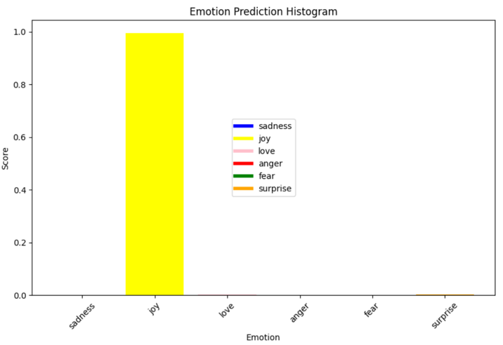
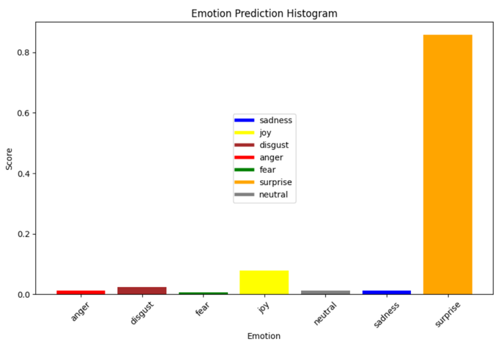
PRELIMINARY EXPERIMENT on two sentences: True Label vs. Distilbert v.s. DistilRoBERTa
Sentence 1: “Sorry I’m late, I was stuck at work. There was this big dinosaur.. thing.. anyway”
True Label
DistilBERT
DistilRoBERTa
DistilRoBERTa more accurate than Distilbert
Sentence 2 ”Oh my God! Ohh! Look at this one! It’s so beautiful!”
True Label
DistilBERT
DistilRoBERTa
True Label
DistiBERT more accurate than DistilRoBERTa

Slide 7
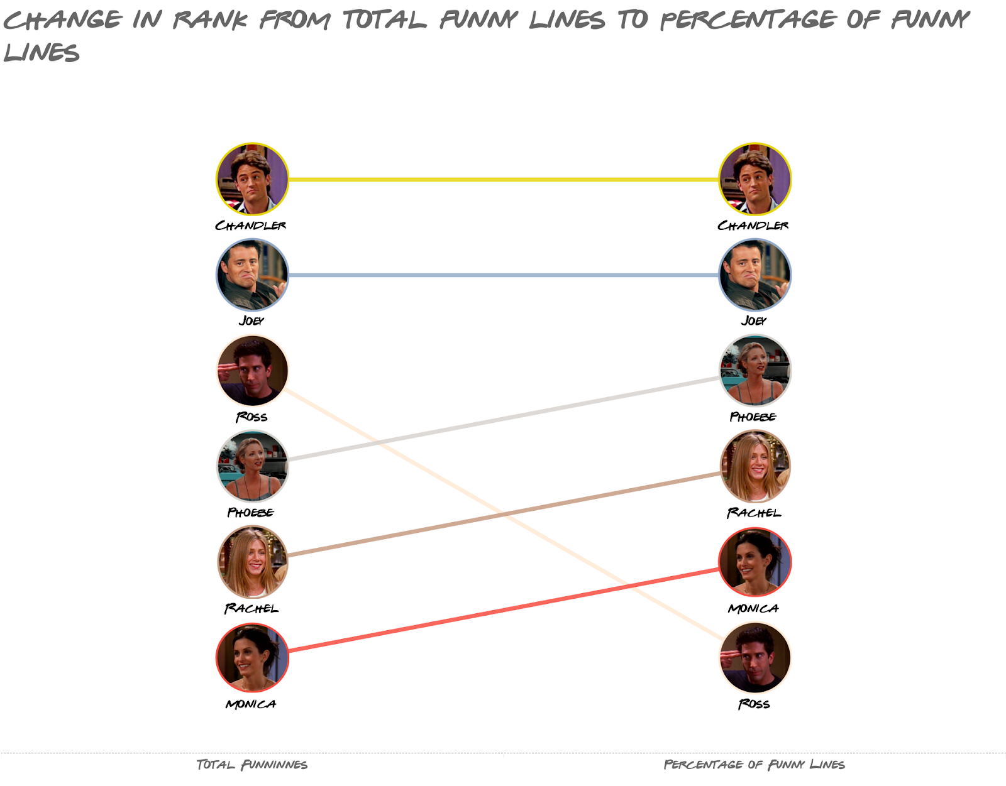
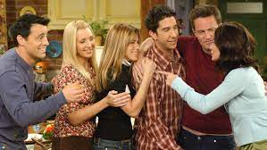
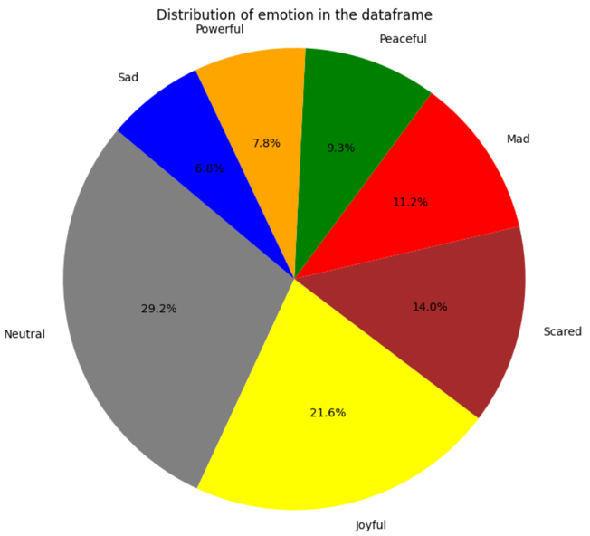
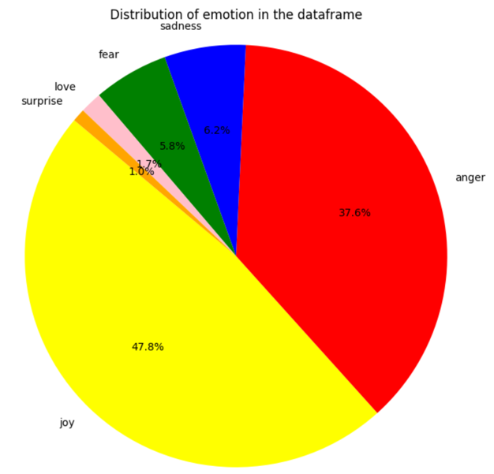
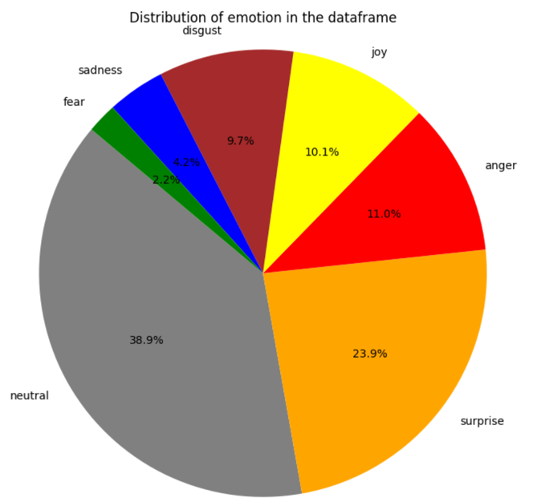
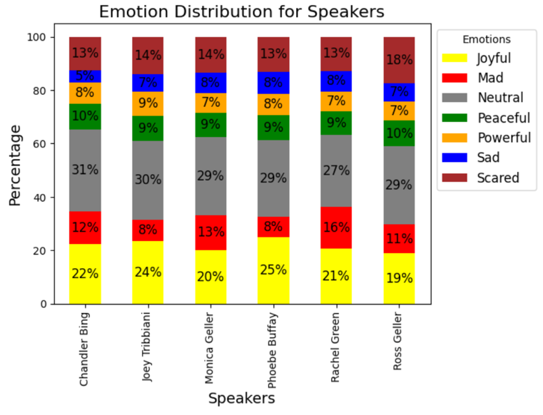
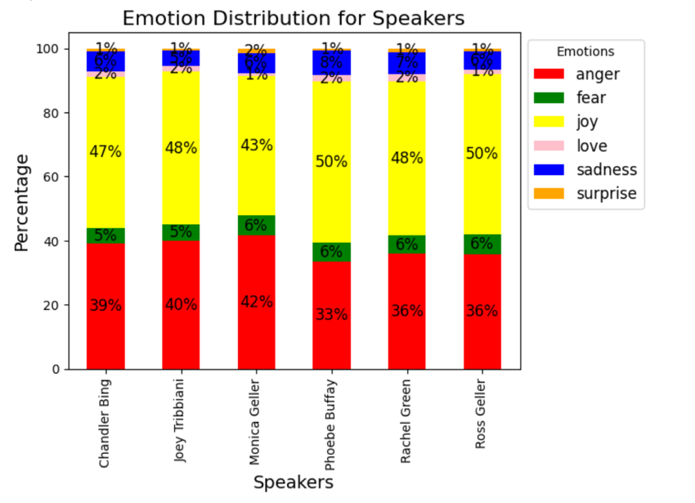
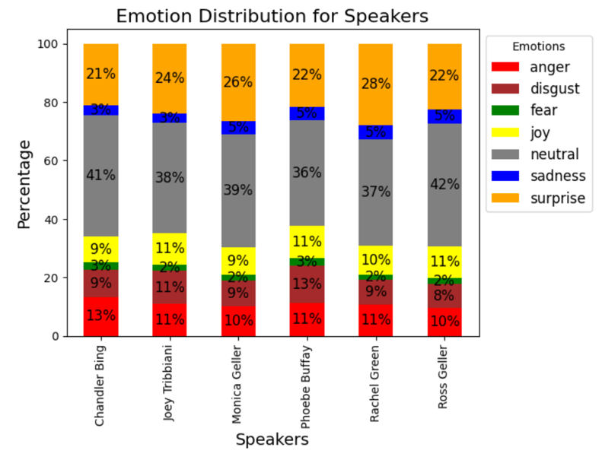
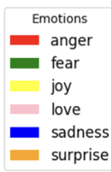
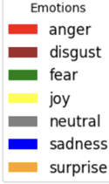
1.EMOTIONAL PROFILES
True Label
DistilBERT
DistilRoBERTa
Predominant emotion (in a sentence): the one with the highest percentage
Distribuition of emotions vs. Emotional Profile: Consistent results within the same dataset

Slide 8

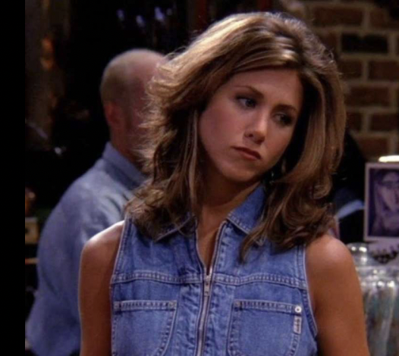
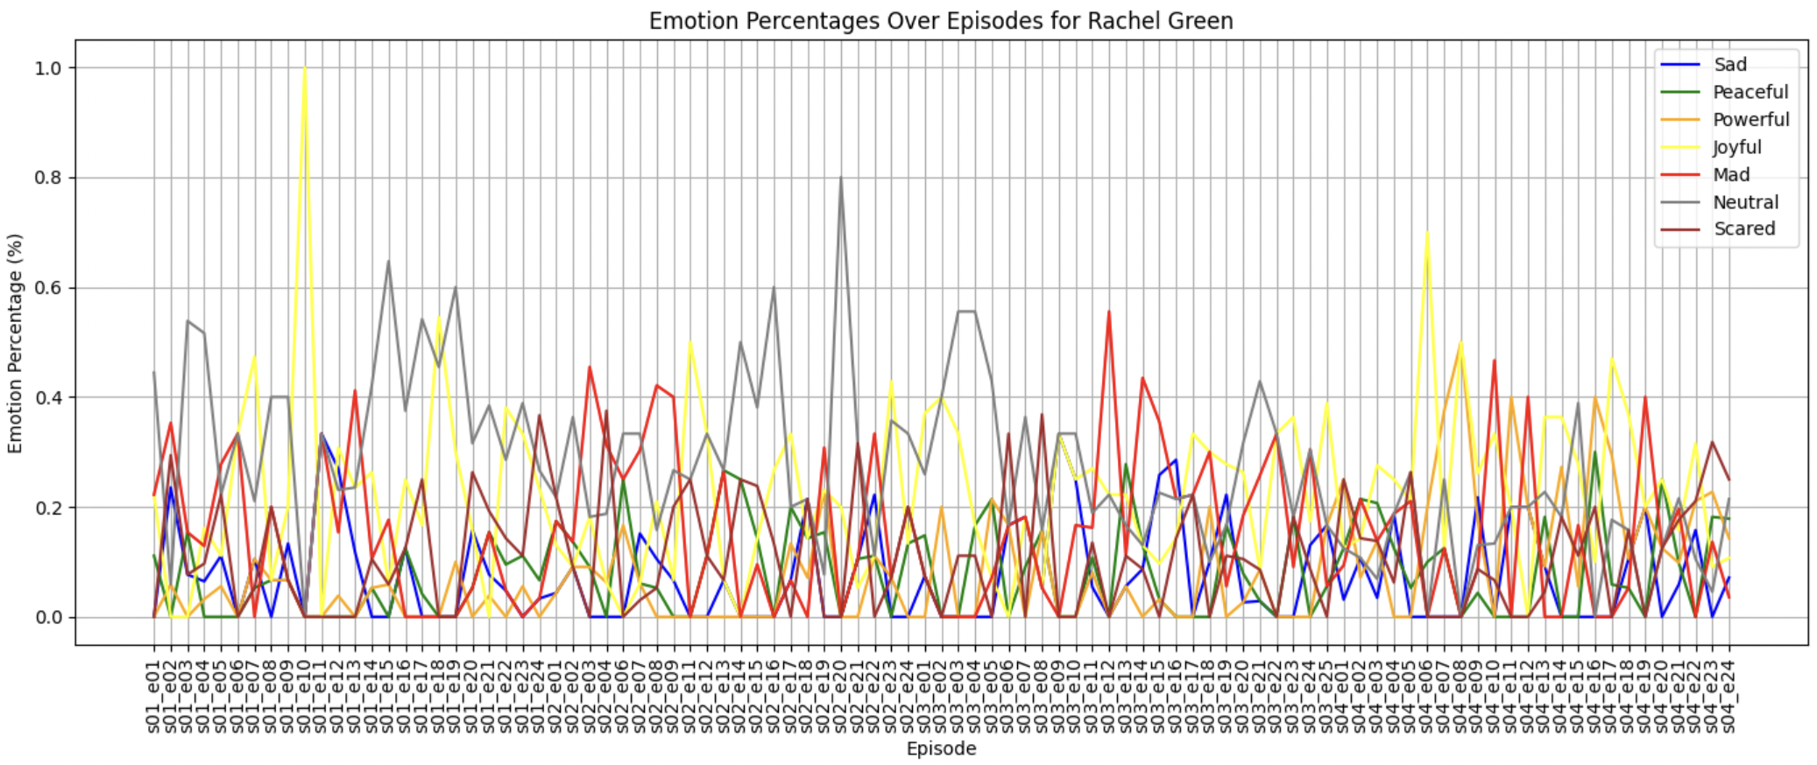
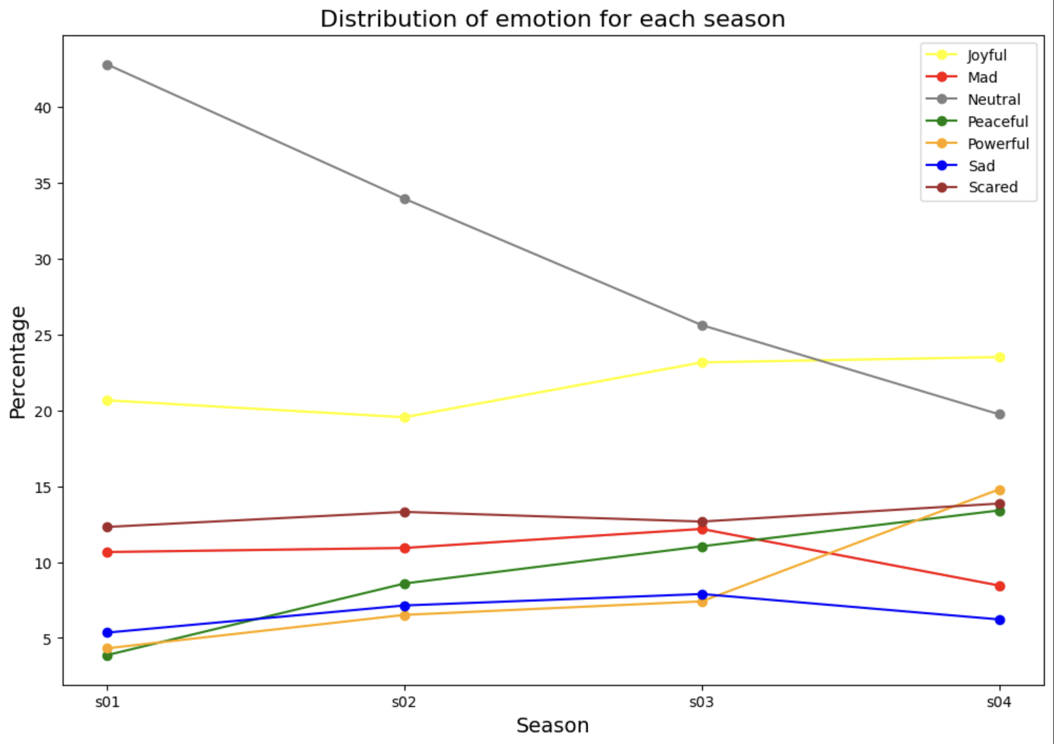
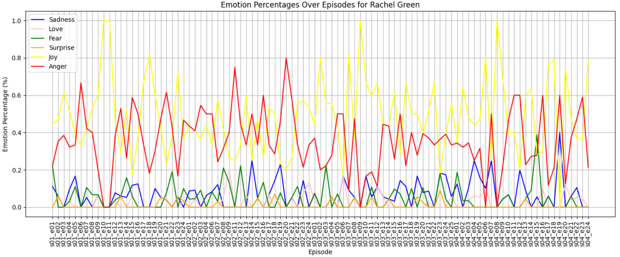
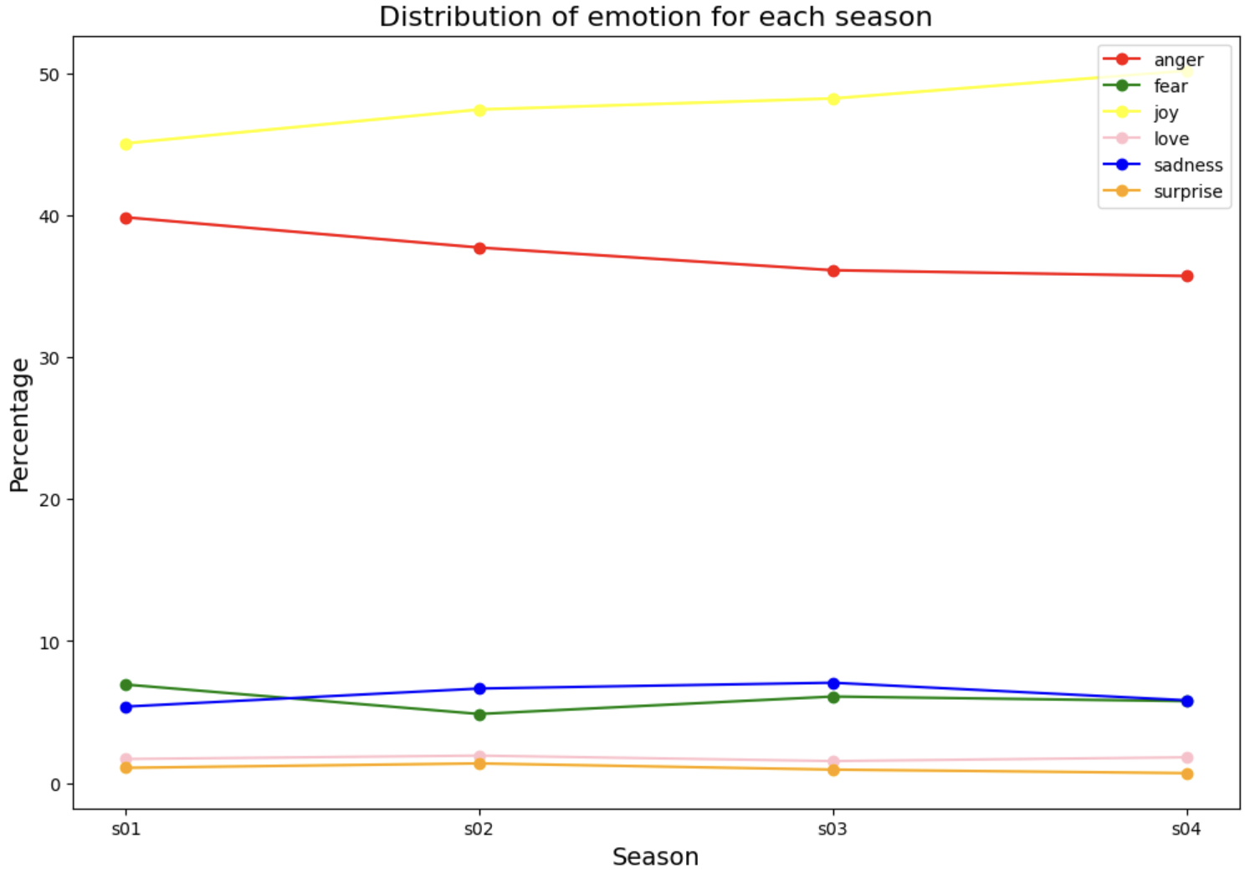
2. Characters’ Emotional Evolution
Rachel: Emotional evolution along all scenes in all episodes
True Label
DistilBERT

Slide 9
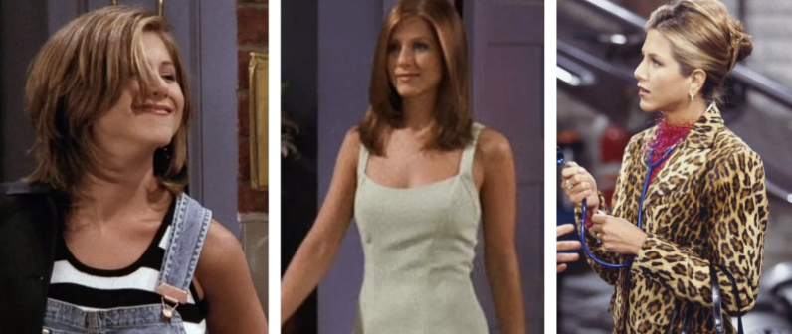
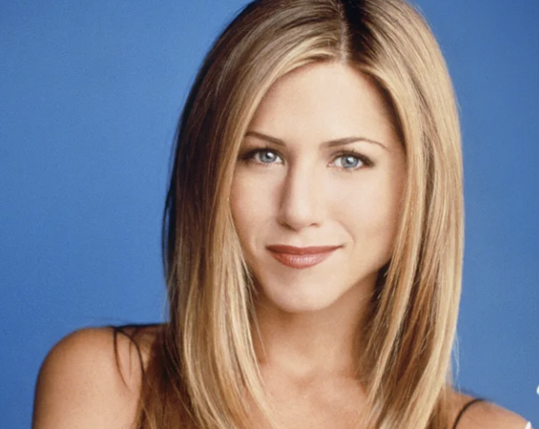
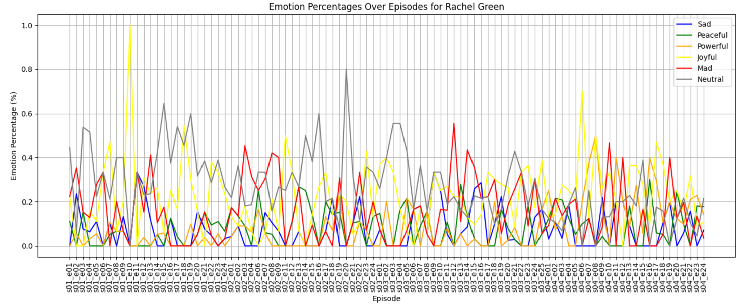
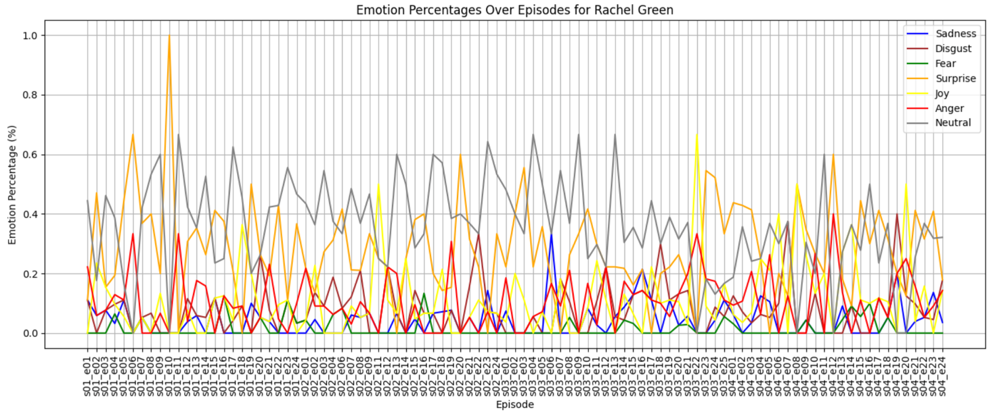
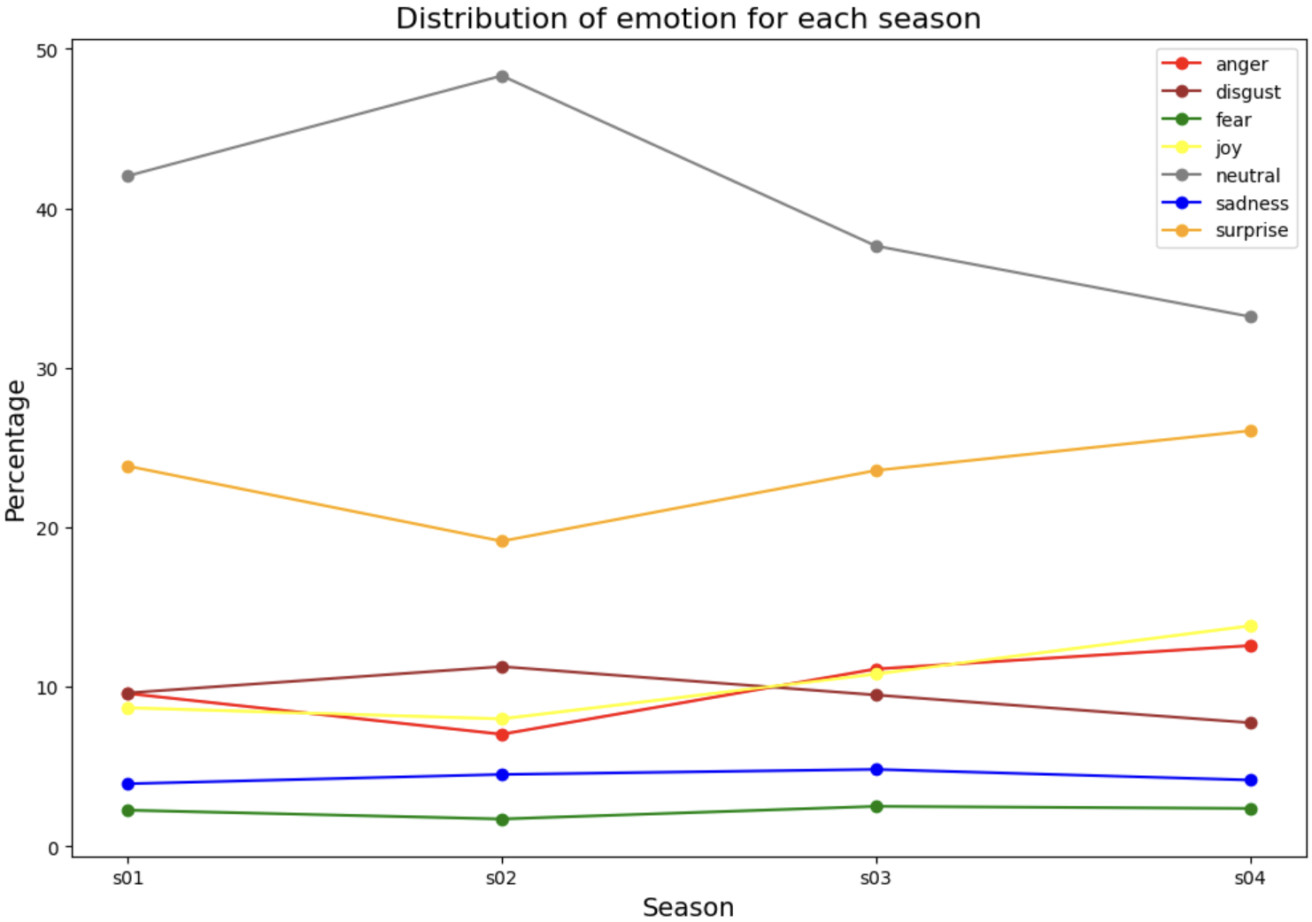
2. Characters’ Emotional Evolution
Emotional state consistency and stability across all seasons
True Label
DistilRoBERTa

Slide 10
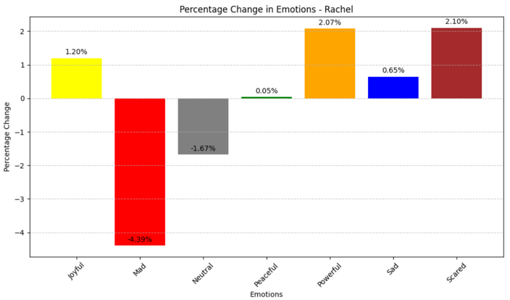
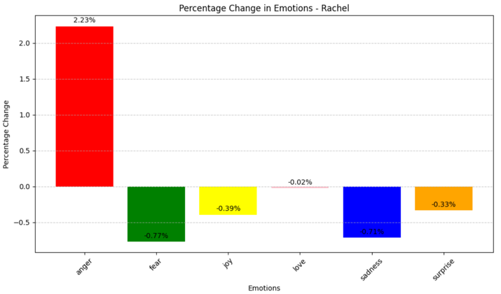
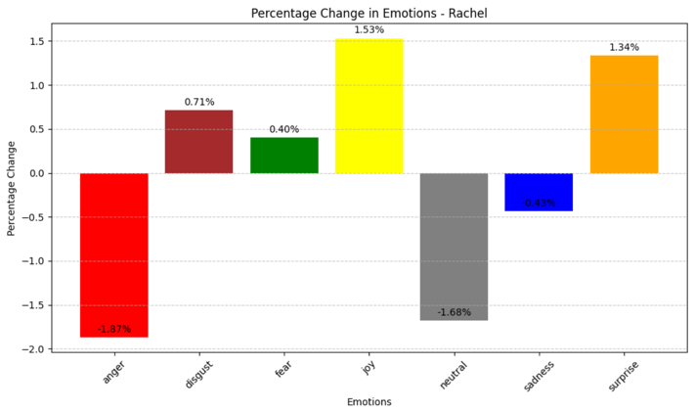
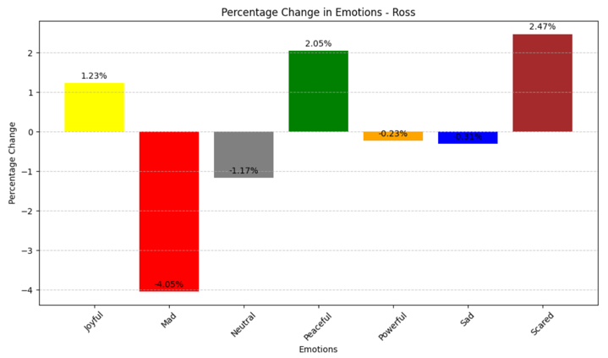
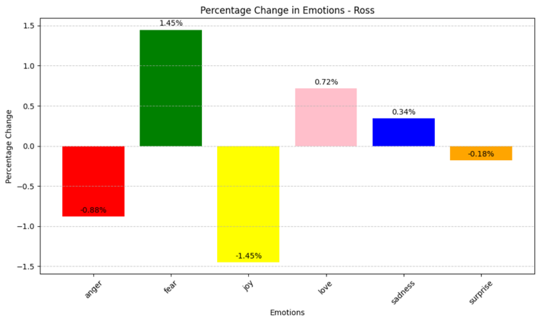
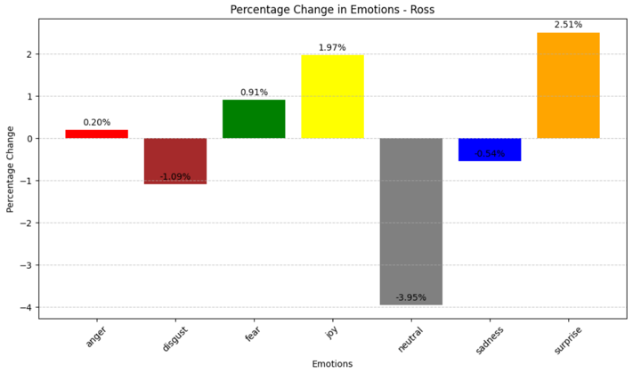
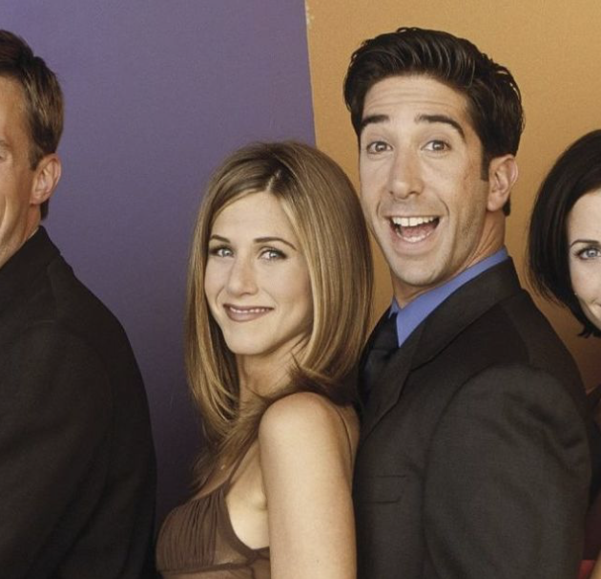
3. Emotional influence
Overall percentage of each emotion i) in all scenes in which Rachel (resp. Ross) was present but Ross (resp. Rachel) was not; ii) in all the scenes in which they were both present .
True Label
DistilBERT
DistilRoBERTa
Ross’ Presence:
Effects on Rachel
Rachel’s Presence:
Effects on Ross
True label: both Rachel and Ross less angry when the other is not present
DistillBERT: Rachel more angry without Ross, Ross less angry without Rachel
DistillRoBERTa: Rachel less angry without Ross, Ross more angry without Rachel

Slide 11
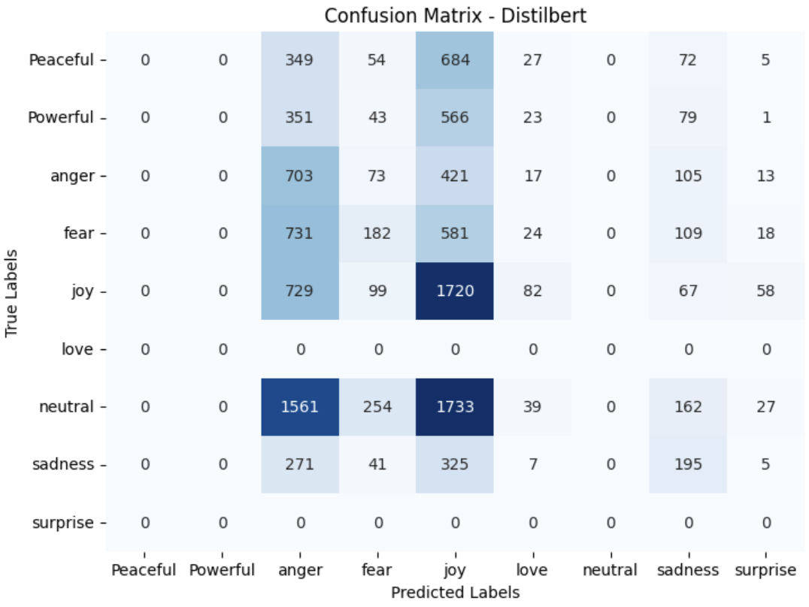
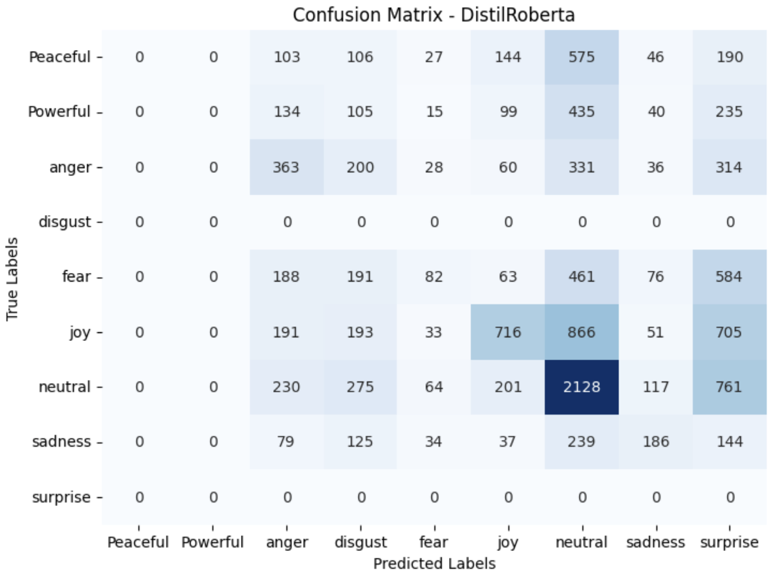
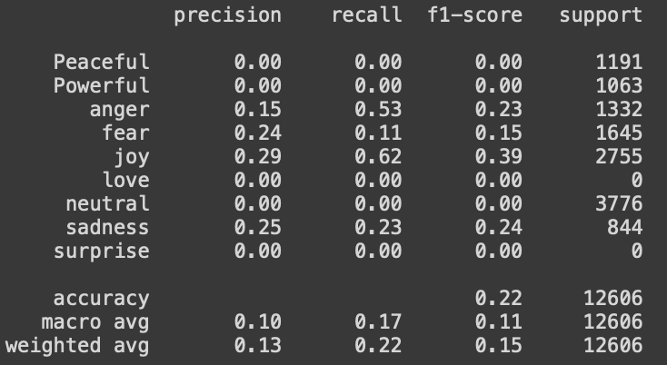
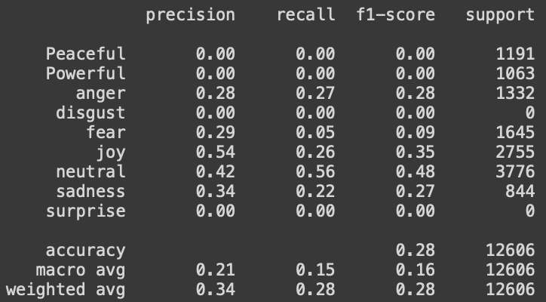
4. Models Performance
Models’ capability of emotional classification w.r.t. the actual labels in the source dataset
accuracy 22%
accuracy 28%

Slide 12
FINAL REMARKS
Project goal: Emotion detection in “Friends” sit com transcripts using two LMs: DistilBERT-base-uncased and Emotion English DistilRoBERTa-base
Comparison of the two LMs against each other and in comparison to a baseline (the emotion-labelled source dataset)
Focus on “Friends” but methodology and code adaptable to other sitcoms
Insights gained:
Understanding emotional behavior of "Friends" characters and over seasons
Impact of "social presence" on individual character emotions
Key Findings:
Similarities and disparities in emotional profiles from LMs and labeled data
Social presence influence on emotions, but variations in which emotions are affected
Different accuracy in predicting emotions based on the dataset's labeled annotations.
Disparities attributed to the different characteristics, pre-training data, and emotion categories of the 2 LMs
Need for further investigation

Slide 13

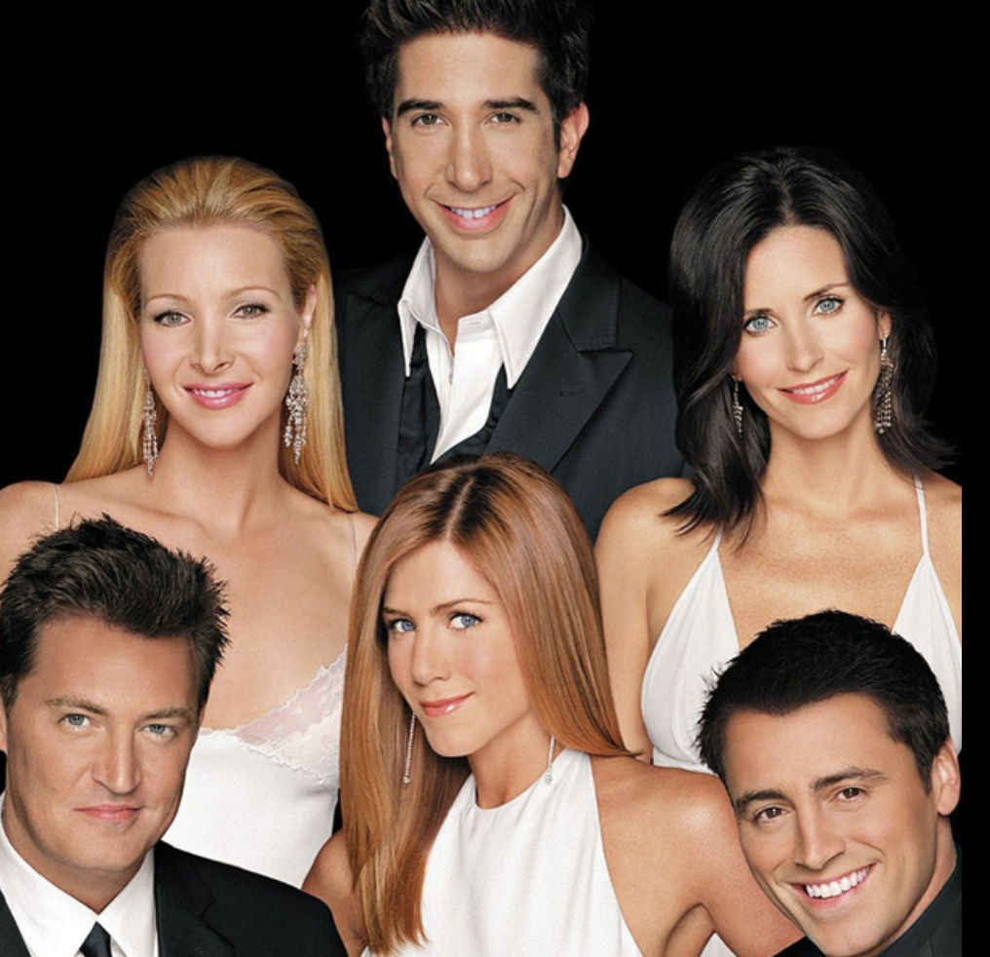
THANK YOU FOR THE ATTENTION Sara Paolini

